Slide 1
Analysis Of US Accident Data
By Group 24

Slide 2
Technologies
GitHub
Jenkins
Aws services(s3,lambda,Glue,Rds,Ec2)

Slide 3
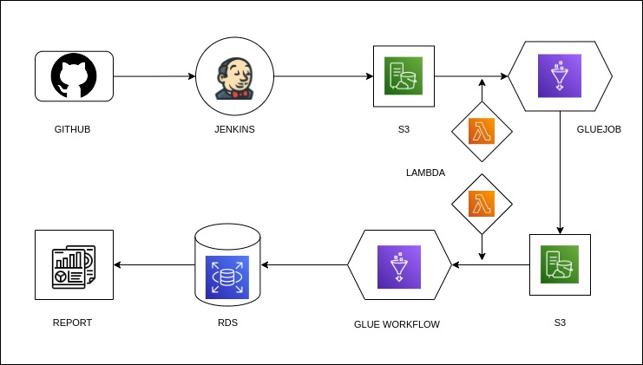
Architecture

Slide 4
CI/CD Implementation Using Jenkins
Jenkins is a open source continuous integration tool.
We have used GitHub as source code repository and Integrate Into Jenkins
and Jenkins will detect the latest commit changes and deploy to the particular
environment.
We automate the build process using GitHub webhook .
As destination repository we have used ‘Aws S3’ bucket.

Slide 5
Transforming And Cleaning Of Raw Data
Here we used glue job with Jupiter notebook script to transform and clean raw data.
As soon as glue job runs it will drop unnecessary columns and add needed column to our data frame
Replaced the complex column name with readable column names.
Then replaced NA values with mean and mode of the respective columns.
Hence we successfully transformed and cleaned raw data and stored again to ‘S3’ in csv format.

Slide 6
Deployment ‘S3’ to ‘RDS’
After cleaning data which is stored in ‘S3’ we use glue workflow to establish connection between ‘S3’ to ‘RDS’.
We used two crawler for ‘RDS’ and ‘S3’ and stored tables in glue database.
Used glue job to transfer ‘S3’ data into ‘RDS’.
Hence we successfully deployed cleaned from S3 to RDS(Mysql) database.

Slide 7
Impactful Insights
We have analyzed data and taken out the important insights which causing the accidents and impact of the accidents.
Causes of accidents due to different road conditions.
Accident cases reported for different humidity, pressures, wind chill, wind speed, visibility
Road Accident Percentage for different Weather Condition in US (2016-2020)
Impact on the severity due to the Accidents
Impact on the severity due to the Accidents on different weather conditions

Slide 8
Thank You

